Slide 1
Teachers Please note:
Slide 3: print out for students to write on
Slides 4 onwards should be used as teacher notes

Slide 2
Topic: Measurement
EQ : How do I convert between units of area and units of volume?
Get your VIVOS
-

Slide 3
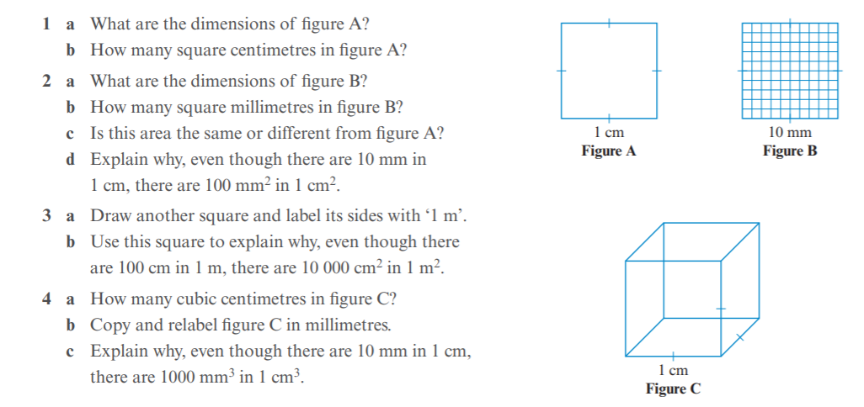
24
7
30
Measurement
Date:
EQ – How do I convert between units of area and units of volume?
Start thinking. Find someone you would like to work with (not socialize with but WORK!
15mins to write responses to these questions

Slide 4
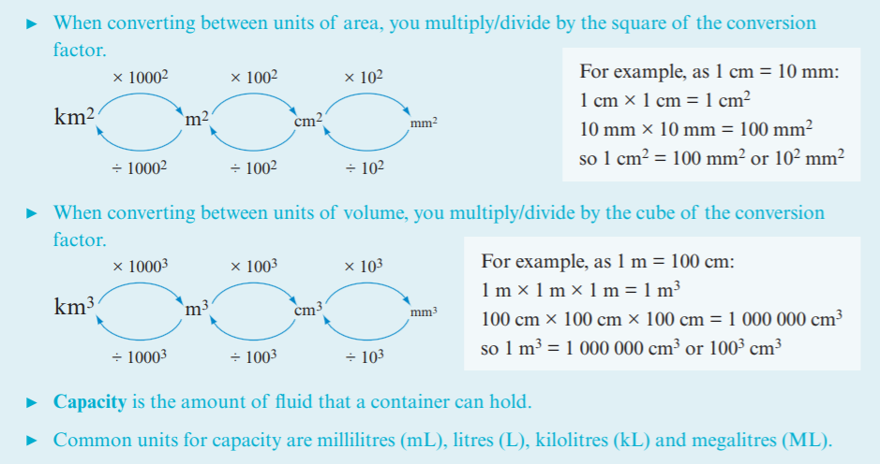
24
7
30
Measurement
Date:
EQ – How do I convert between units of area and units of volume?

Slide 5
24
7
30
Measurement
Date:
EQ – How do I convert between units of area and units of volume?
Get students to form 4 column notes or get them to divide a spare piece of paper in 4 to add in the 4 examples. Glue spare piece of paper into INB

Slide 6
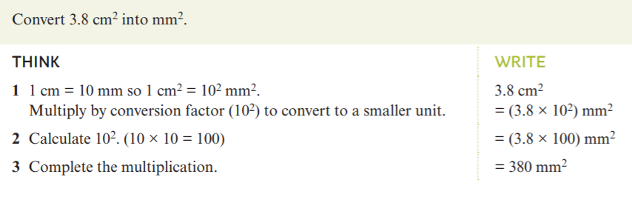
24
7
30
Measurement
Date:
EQ – How do I convert between units of area and units of volume?
Example 1: Converting to a smaller area unit

Slide 7
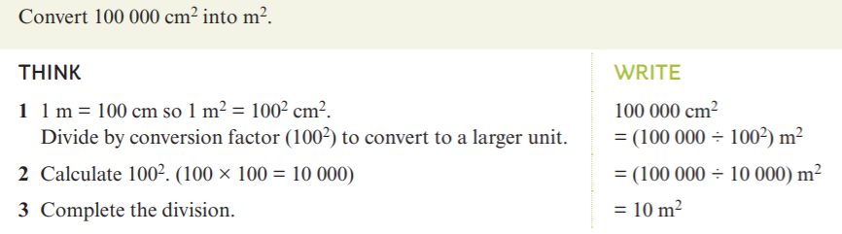
24
7
30
Measurement
Date:
EQ – How do I convert between units of area and units of volume?
Example 2: Converting to a larger area unit

Slide 8
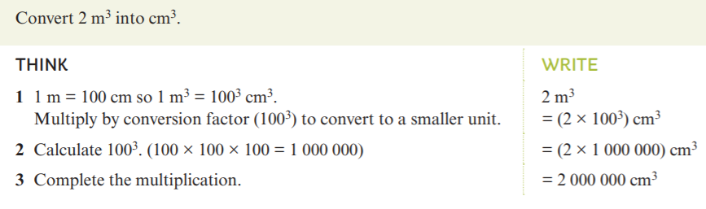
24
7
30
Measurement
Date:
EQ – How do I convert between units of area and units of volume?
Example 3: Converting to a smaller volume unit

Slide 9
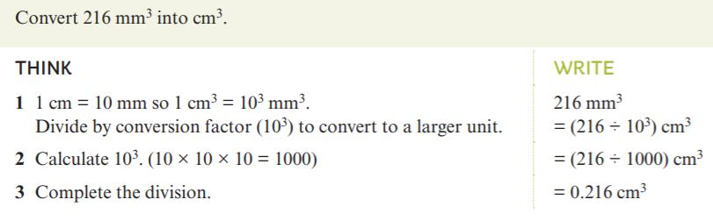
24
7
30
Measurement
Date:
EQ – How do I convert between units of area and units of volume?
Example 3: Converting to a larger volume unit

Slide 10
24
7
30
Measurement
Date:
EQ – How do I convert between units of area and units of volume?
Complete Converting Units worksheet
Complete Converting Units- worded questions worksheet

